Slide 1
Information Processing Techniques
Week 11
Abeeha Sattar

Slide 2
REST v/s SOAP

Slide 3
REST v/s SOAP
Simple web service as an example: querying a phonebook application for the details of a given user
Using Web Services and SOAP, the request would look something like this:
<?xml version="1.0"?>
<soap:Envelope
xmlns:soap="http://www.w3.org/2001/12/soap-envelope" soap:encodingStyle="http://www.w3.org/2001/12/soap-encoding">
<soap:body pb="http://www.acme.com/phonebook">
<pb:GetUserDetails>
<pb:UserID>12345</pb:UserID>
</pb:GetUserDetails>
</soap:Body>
</soap:Envelope>

Slide 4
REST v/s SOAP
Simple web service as an example: querying a phonebook application for the details of a given user
And with REST? The query will probably look like this:
http://www.example.com/phonebook/UserDetails/12345
GET /phonebook/UserDetails/12345 HTTP/1.1
Host: www.example.com
Accept: application/xml
Complex query:
http://www.example.com/phonebook/UserDetails?firstName=John&lastName=Doe

Slide 5
Web
Roy Fielding and his doctoral thesis, "Architectural Styles and the Design of Network-based Software Architectures."
Why is the Web so prevalent and ubiquitous?
What makes the Web scale?
How can I apply the architecture of the Web to my own applications?
The set of the architectural principles given by Roy Fielding to answer these questions - REpresentational State Transfer (REST)

Slide 6
REST Principles
Addressable resources
-Resource oriented, and each resource must be addressable via a URI
-The format of a URI is standardized as follows:
scheme: //host:port/path?queryString#fragment
A uniform, constrained interface
-Uses a small set of well-defined methods to manipulate your resources.
-The idea behind it is that you stick to the finite set of operations of the application protocol you're distributing your services upon.

Slide 7
Why REST?

Slide 8
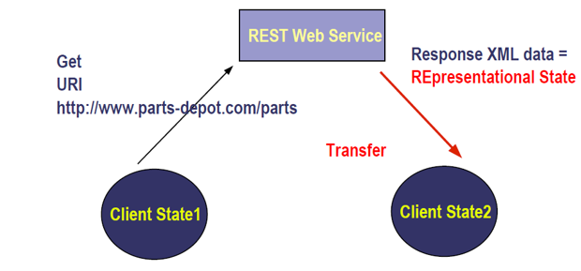
What is REST?
REpresentational State Transfer

Slide 9
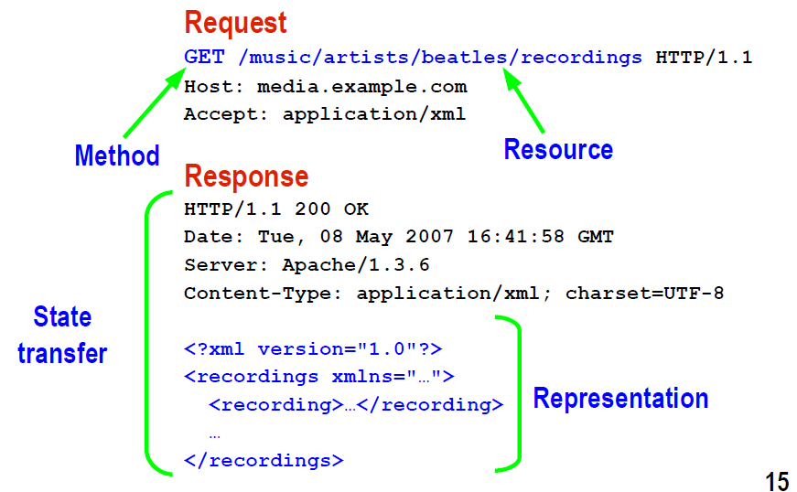
HTTP Request/Response As REST

Slide 10
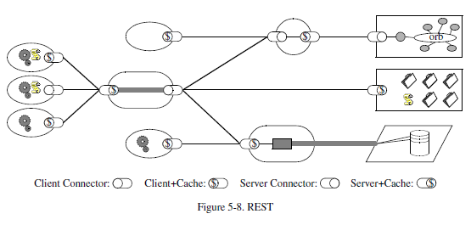
RESTful Architectural Style

Slide 11
Set of Constraints
Client-Server: Separation of concerns
Client-Stateless-Server: Visibility, Reliability, Scalability
Caching : improves efficiency, scalability and user perceived performance, reduces average latency
Uniform Interface: simplify overall system architecture and improved visibility of interactions
Layered System: Simplifying components, Shared caching, Improved Scalability, Load balancing
Code-On-Demand: Simplifies clients, Improves extensibility

Slide 12
WADL

Slide 13
WADL
Application
Grammar
Include
Resources
Resource
Resource Type
Method
Request
Response
Representation
Param
Link
Doc

Slide 14
Why do we need Web APIs?
If your app - your business's data model - has an API, then suddenly your Web API is opened up to native apps, iPhone apps, Windows 8 apps, whatever, apps. It's Web Services.
You can use XML or JSON or something else with Your API. JSON is nice for mobile apps with slow connections.

Slide 15
What is a Web API?
ASP.NET Web API is a framework that makes it easy to build HTTP services that reach a broad range of clients, including browsers and mobile devices.
ASP.NET Web API is an ideal platform for building RESTful applications on the .NET Framework.

Slide 16
HTTP Verbs
GET
The GET method requests a representation of the required resource. Requests using GET should only retrieve data
Example: GET http://www.example.com/customers/12345
POST
The POST method is used to submit and entity to the specified resource, often causing a change in the states or side effects on the server
Example: POST http://www.example.com/customers
PUT
The PUT method replaces all current representations of the target resource with the request payload
Example: PUT http://www.example.com/customers/12345
DELETE
The DELETE method deletes the specified resource
Example: DELETE http://www.example.com/customers/12345
Notes:
For POST, the information is in the request body

Slide 17
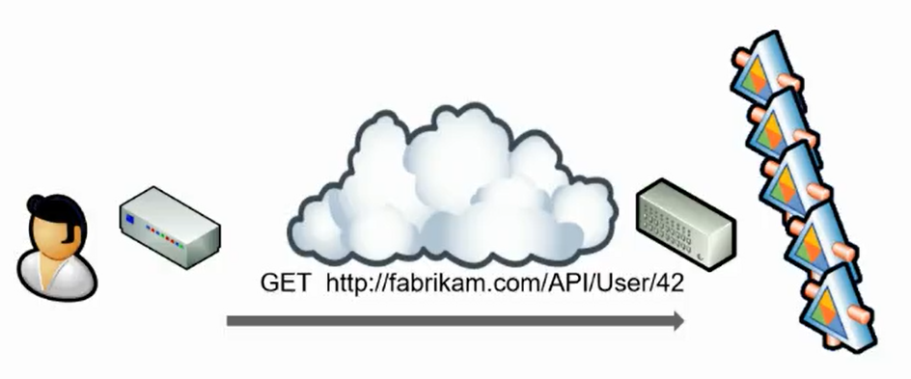
Scalability
Notes:
Stateless and Stateful Servers
Stateless Servers are easier to scale.
In Stateful Servers, one server will need to be dedicated to storing session information

Slide 18
When to use WCF or ASP.NET Web API
Use WCF…
Use ASP.NET Web API…
If you are limited to .Net 3.5
If you are exposing SOAP based services
If you need to support multiple protocols
If you need to support WS-* transaction
If you need to achieve message level security
If you need to reach wider and diverse cross platform clients / devices
If you need to leverage the benefits of http

Slide 19
Comparison
Feature | WCF | WEB API
Transport | HTTP/S, TCP, UDP, MSMQ, named pipes, custom | HTTP/S
Protocols | WS* | HTTP
Content Format | SOAP+XML | Any media type, format
Types | Data contracts (opt in) | CLR Types (opt out)
Service Interface | Service contracts | URL patterns, HTTP methods
State Management | Stateless with Per Call | Stateless
Caching | Handled by application | Built-in to HTTP Prefer application control
Hosting | IIS or self-host | I IS or self-host
Error Handling | Faults. behaviors | Exceptions, HTTP status codes filters
Security | Windows, Basic, Certificate WS*, Authorization header | Windows. Basic, Certificate Authorization header
Client | Proxy Generation, Shared Libraries | lApiExplorer discovery, Shared Libraries

Slide 20
Fin.

